Slide 1


Institute of Emerging Careers
Capstone Project Presentation
Presented By
Guided By
MUHAMMAD HUSSAIN
Sir Muhammad Hamza

Slide 2

NORTHWIND DATABASE
Northwind is a medium sized
online store, that provides e-commerce services to its customer via shippers from around the globe.

Slide 3
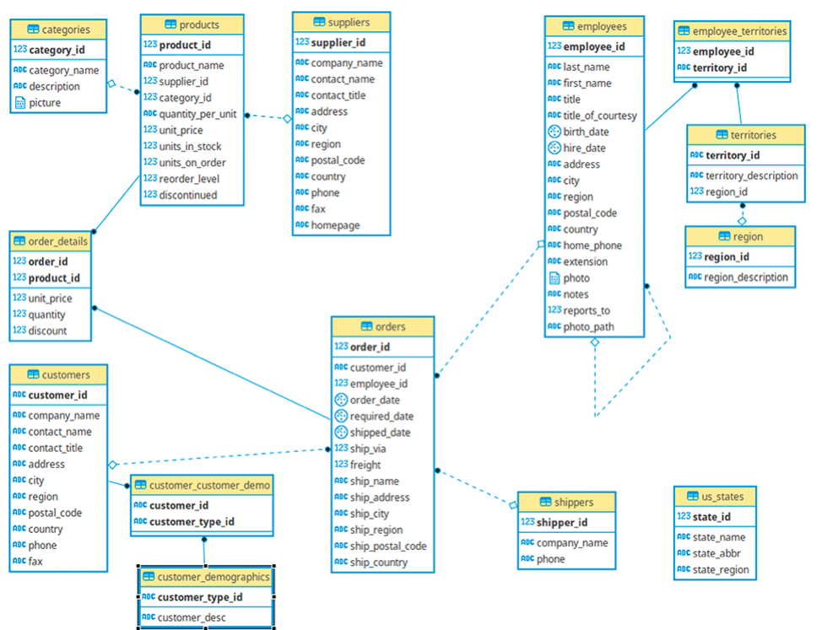
Northwind Database Schema
Contain employees,customers and sales data

Slide 4

Ways to get Trust of Customers
Loyal Customers
Discount Customers
Impulsive Customers
Need-Based Customers
Wandering Customers
Potential Customers

Slide 5
Loyal Customers
Impulsive Customers
Keep them Excited about your services by studying their behaviour and anticipating their needs.
Explain to them the details about the deals and offer them an added value that they can’t get anywhere else
Discount Customers
Need-Based Customers
Enlighten them about the benefits of your products and give them a live customer service option
Minimize the time you give to these customers but make sure that they still feel valued
Potential Customers
Wandering Customers
Ensure that they can purchase your products conveniently and get the help they need quickly.
let them know about the advantages they can get from your products and services.

Slide 6

Business Problems And Their Solutions

Slide 7
Top 10 Areas With Fewer Orders
We have determined, in this analyses, the top 10 areas with fewer orders.
This analyses can help us to understand what is the main cause of fewer orders in these areas and help us increase orders by running campaigns, giving discounts and other benefits to the customers.

Slide 8
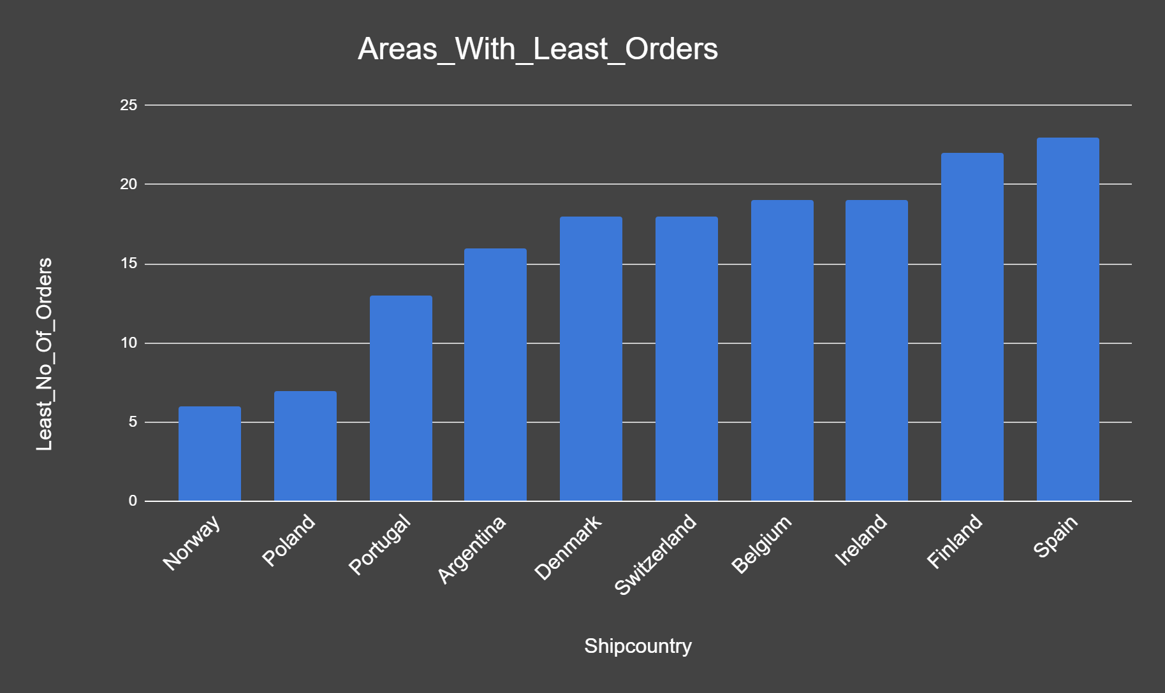
Top 10 Areas With
Fewer Orders

Slide 9
Top 5 Comp. Handling More Order Within Certain Areas
In this analyses, we found the top 5 companies which are handling more orders in certain cities.
This analyses guide me that we should increase our connections with those companies and offer them more products and more resources to grow our business

Slide 10
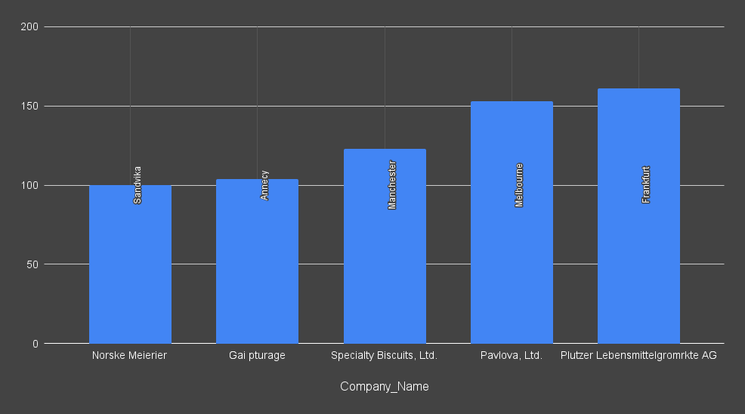
Top 5 Comp.
Handling
More Order

Slide 11
Top 5 Employees Handling More Orders
In this analyses, we have found, the top 5 employees who are handling more orders than other employees.
This analyses helped us so that we can keep giving financial rewards to our those employees and keep them motivated.

Slide 12
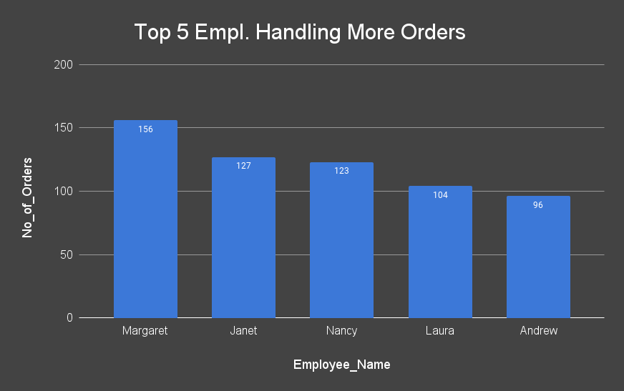
Top 5 Employees
Handling More Orders

Slide 13
Top 7 Ranking Products & Categories Within Certain Areas
We have determined, in this analyses, the top 5 ranking products based on the revenue they generated.
This analyses help me to display more popular items beforehand to increase order count and sale numbers in those areas.

Slide 14
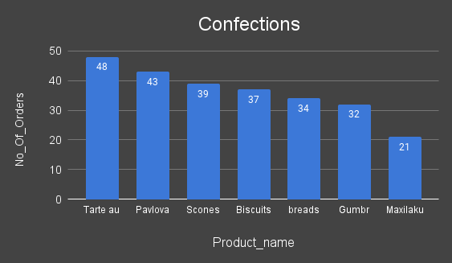
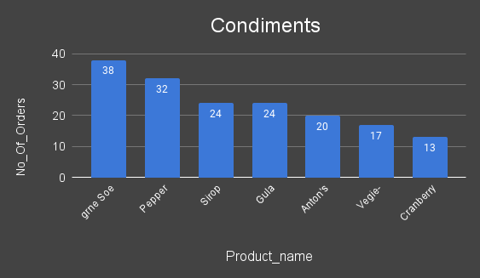
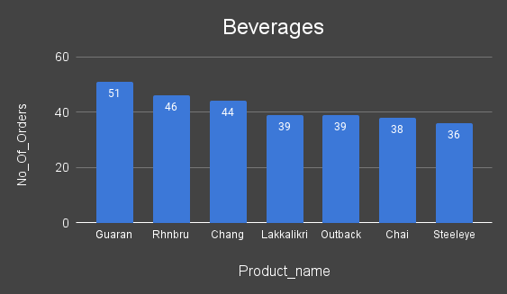
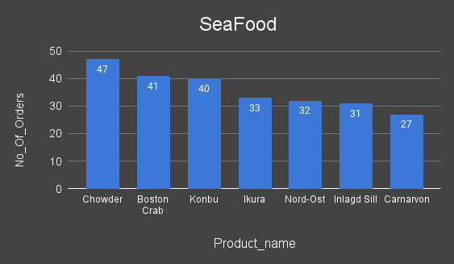
Top 7 products in Each Category

Slide 15


